Slide 1

CSE 591 Storytelling in Visualization
Ross Maciejewski
rmacieje@asu.edu

Slide 2
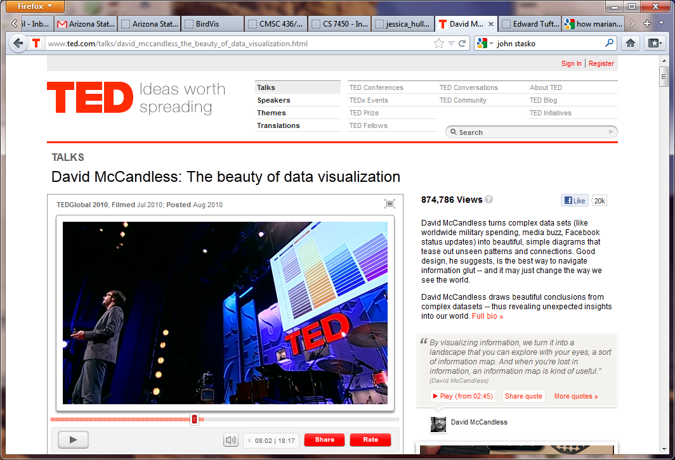
The Beauty of Data Visualization
http://www.ted.com/talks/david_mccandless_the_beauty_of_data_visualization.html

Slide 3
Purpose of Visualization
Two main uses of visualization
Analysis – Understand your data better and act upon that understanding
Presentation – Communicate and inform others more effectively
Last time, we discussed animation and how it can be used to facilitate presentations
This leads to today’s discussion of using visualization to tell a story
Parts of this slide borrowed from John Stasko’s Information Visualization Course Lecture: Storytelling in InfoVis: http://www.cc.gatech.edu/~stasko/7450/11s/Talks/storytelling.pdf

Slide 4
Telling Stories
Data visualization can help to communicate ideas, summarize, influence, unite, explain, persuade
Visuals can serve as evidence or support
Think about Han Rosling’s TED Talk with Gapminder
Where else do we see people telling stories with data?
Parts of this slide borrowed from John Stasko’s Information Visualization Course Lecture: Storytelling in InfoVis: http://www.cc.gatech.edu/~stasko/7450/11s/Talks/storytelling.pdf

Slide 5
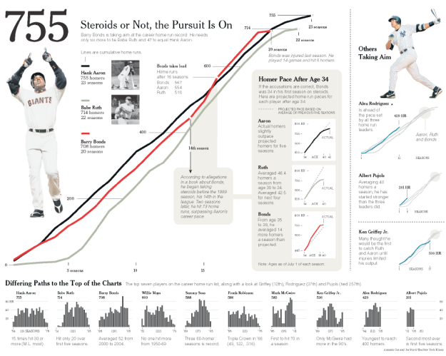

Slide 6
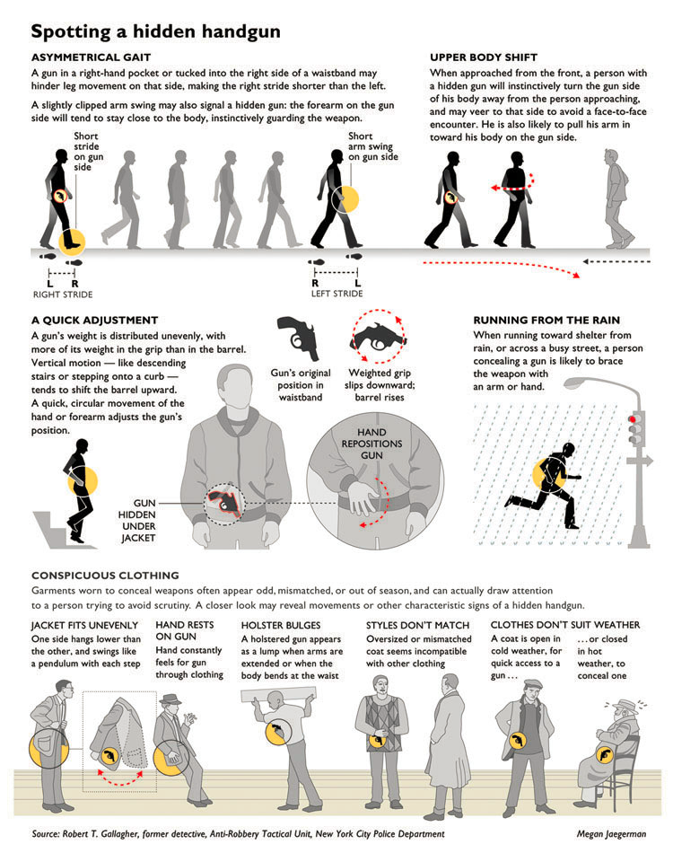
http://www.edwardtufte.com/bboard/q-and-a-fetch-msg?msg_id=0002w4

Slide 7
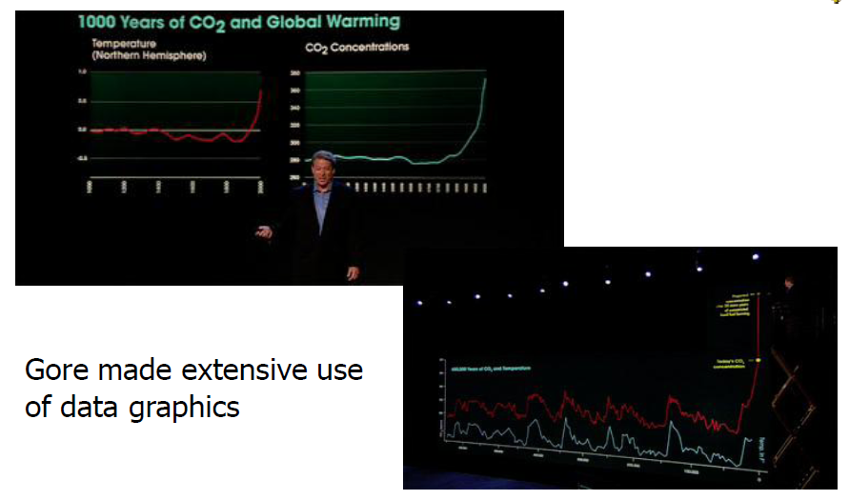
An Inconvenient Truth
Parts of this slide borrowed from John Stasko’s Information Visualization Course Lecture: Storytelling in InfoVis: http://www.cc.gatech.edu/~stasko/7450/11s/Talks/storytelling.pdf

Slide 8
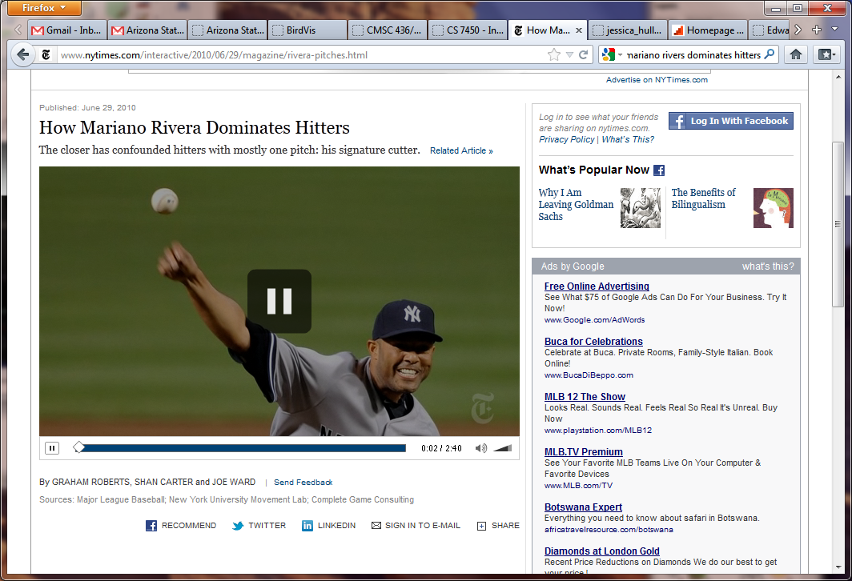
Mariano Rivera
http://www.nytimes.com/interactive/2010/06/29/magazine/rivera-pitches.html

Slide 9
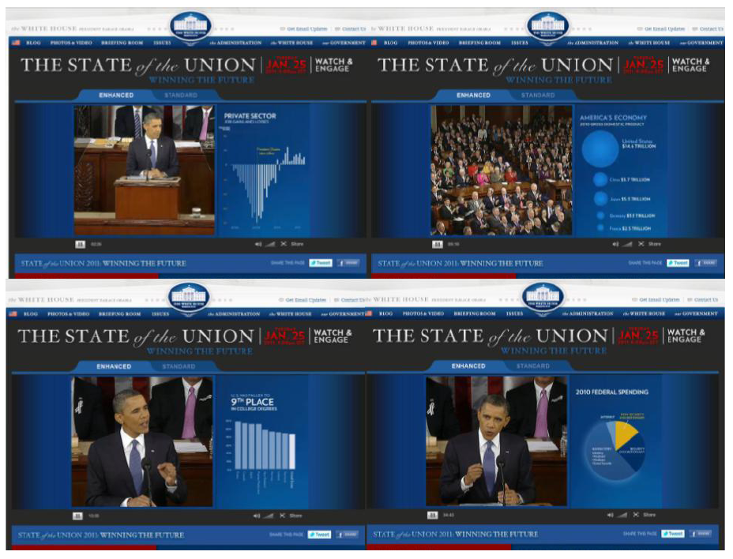
The President Goes Interactive

Slide 10
Characterizing the Area
Studied storytelling: Described topics as “Narrative Visualization”
How does this differ from traditional forms of storytelling
Reviews the design space
Characterizes the genres
Describes a framework
E. Segel and J. Heer, "Narrative Visualization: Telling Stories with Data", IEEE Trans. on Visualization and Computer Graphics, Vol. 16, No. 6, Nov.-Dec. 2010, pp. 1139-1148.

Slide 11
Storytelling with Data
Recently, news organizations have begun regularly incorporating dynamic graphics into their journalism
Visualization designers are “melding the skills of computer science, statistics, artistic design and storytelling”¹
Effective story-telling “requires skills like those familiar to movie directors, beyond a technical expert’s knowledge of computer engineering and science.”²
How can we design tools to support richer forms of storytelling?³
1 - K. Cukier. Show Me: New ways of visualising data. http://www..economist.com/node/15557455, 2010.
2 - K. Cukier. Show Me: New ways of visualising data. http://www..economist.com/node/15557455, 2010.
3 - E. Segel and J. Heer, "Narrative Visualization: Telling Stories with Data", IEEE Trans. on Visualization and Computer Graphics, Vol. 16, No. 6, Nov.-Dec. 2010, pp. 1139-1148.

Slide 12
Narrative Structure
We have a notion of a chain of causally related events
Stories often have a beginning middle and end
Much work has been done on developing typologies of narratives
Visualization brings with it text, images, video and interactivity, so what kind of typology can be developed in this setting?
E. Segel and J. Heer, "Narrative Visualization: Telling Stories with Data", IEEE Trans. on Visualization and Computer Graphics, Vol. 16, No. 6, Nov.-Dec. 2010, pp. 1139-1148.

Slide 13
Visual Narratives
Overview – utilize an establishing shot or overview to introduce the scene
Not all elements in a scene are of equal importance, so we can manipulate a scene to direct attention
Cultural bias in reading order bias where people look first
Where else in class have we talked about using such bias to direct attention?
Scene changes – try to establish some connection between scenes in order to maintain coherence
McCloud’s Understanding Comics presents a taxonomy of different transitions
E. Segel and J. Heer, "Narrative Visualization: Telling Stories with Data", IEEE Trans. on Visualization and Computer Graphics, Vol. 16, No. 6, Nov.-Dec. 2010, pp. 1139-1148.
S. McCloud. Understanding Comics. Kitchen Sink Press, 1993.
Notes:
Pre-attemptive cues can be used to grab user's attention

Slide 14
Design Space
Genre
Visual Narrative
Visual structuring
Highlight
Transition Guidance
Narrative Structure
Ordering
Interactivity
Messaging
E. Segel and J. Heer, "Narrative Visualization: Telling Stories with Data", IEEE Trans. on Visualization and Computer Graphics, Vol. 16, No. 6, Nov.-Dec. 2010, pp. 1139-1148.

Slide 15
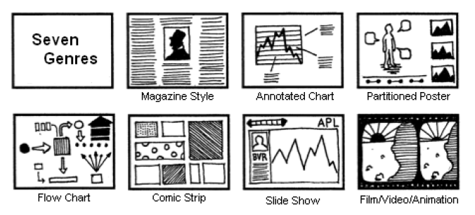
Genres
E. Segel and J. Heer, "Narrative Visualization: Telling Stories with Data", IEEE Trans. on Visualization and Computer Graphics, Vol. 16, No. 6, Nov.-Dec. 2010, pp. 1139-1148.

Slide 16
Observations
Clusters of different ordering structures
Consistency of interaction design
Under-utilization of narrative messaging

Slide 17
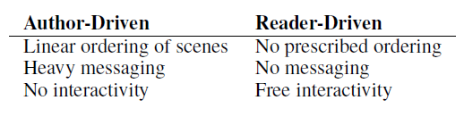
Approach
Author-driven vs. reader-driven
Common patterns
Martini glass
Interactive slideshow
Drill-down story
E. Segel and J. Heer, "Narrative Visualization: Telling Stories with Data", IEEE Trans. on Visualization and Computer Graphics, Vol. 16, No. 6, Nov.-Dec. 2010, pp. 1139-1148.

Slide 18
Martini Glass Structure
Begins with an author-driven approach, initially using questions, observations or written articles to introduce the visualization
Once the author’s intended narrative is complete, the visualization opens up to a reader-driven stage
This type of structure is most common with interactive visualizations accompanying stories
E. Segel and J. Heer, "Narrative Visualization: Telling Stories with Data", IEEE Trans. on Visualization and Computer Graphics, Vol. 16, No. 6, Nov.-Dec. 2010, pp. 1139-1148.

Slide 19
Interactive Slideshow
Follows traditional slideshow structure but incorporates interactions mid-narrative
Allows the user to further explore particular points of the presentation
Works well with complex datasets and complex narratives
In complex datasets, this structure allows the author to walk the user through data-dimensions and manipulations
In narratives, this ensures that the user only moves forward in the presentation when he is ready to do so
E. Segel and J. Heer, "Narrative Visualization: Telling Stories with Data", IEEE Trans. on Visualization and Computer Graphics, Vol. 16, No. 6, Nov.-Dec. 2010, pp. 1139-1148.

Slide 20
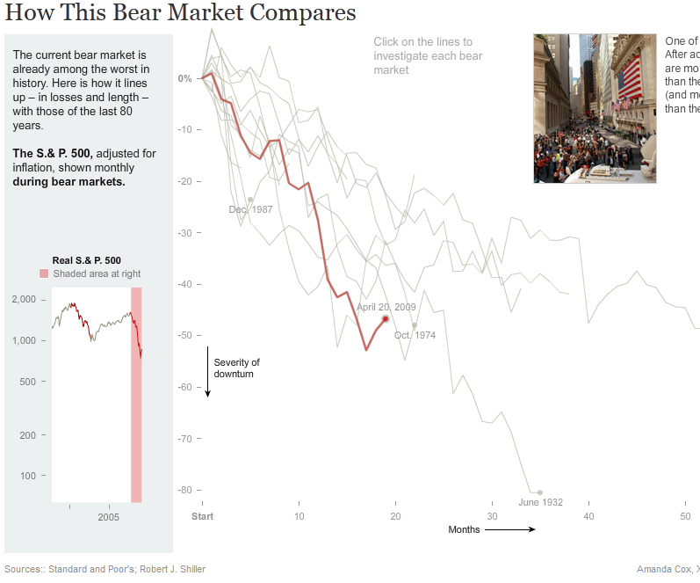
Drill-Down Story
Presents a general theme and then allows the user to choose among a variety of instances
http://www.nytimes.com/interactive/2008/10/11/business/20081011_BEAR_MARKETS.html
E. Segel and J. Heer, "Narrative Visualization: Telling Stories with Data", IEEE Trans. on Visualization and Computer Graphics, Vol. 16, No. 6, Nov.-Dec. 2010, pp. 1139-1148.

Slide 21
Visualization Rhetoric
Goal of this work was to better understand the interpretation process of visualization, this paper investigates rhetorical strategies and effects in narrative visualization by addressing the following research questions:
What conventions are used, and to what extent are specific techniques associated with different editorial layers
In what ways can factors external to the visualization itself influence the rhetoric
How do communicative and explorative rhetorical strategies effectively work together in visualization
J. Hullman and N. Diakopoulos. Visualization Rhetoric: Framing Effects in Narrative Visualization. IEEE Transactions on Visualization and Computer Graphics. October 2011

Slide 22
Information Access Rhetoric
First decision made by a designer is often what data to represent
In order to simplify complex ideas it is often helpful to keep distracting information to a minimum
Omissions are least likely to be explicitly indicated by the visualization
May be motivated by knowledge assumptions of the user
Can transfer choice of omission to user by providing filter controls
J. Hullman and N. Diakopoulos. Visualization Rhetoric: Framing Effects in Narrative Visualization. IEEE Transactions on Visualization and Computer Graphics. October 2011

Slide 23
Provenance Rhetoric
Data provenance
Citing and/or linking data sources
Additional references
Methodological choices
Representing uncertainty
Error bars
Textual means
Confidence intervals
J. Hullman and N. Diakopoulos. Visualization Rhetoric: Framing Effects in Narrative Visualization. IEEE Transactions on Visualization and Computer Graphics. October 2011

Slide 24
Mapping Rhetoric
Refers to how a piece of information will be translated to a visual feature
Obscuring can result from introducing noise into a representation (for example adding a gratuitous 3rd dimension)
Think about how size and color can affect what is being seen
J. Hullman and N. Diakopoulos. Visualization Rhetoric: Framing Effects in Narrative Visualization. IEEE Transactions on Visualization and Computer Graphics. October 2011

Slide 25
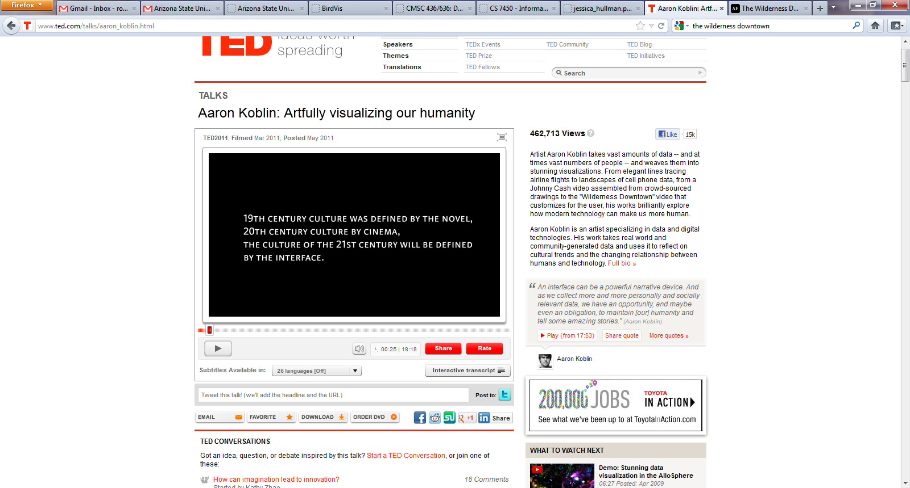
Visualizing our Humanity
http://www.ted.com/talks/aaron_koblin.html

Slide 26
Readings and Homework
Required Reading:
E. Segel and J. Heer, "Narrative Visualization: Telling Stories with Data", IEEE Trans. on Visualization and Computer Graphics, Vol. 16, No. 6, Nov.-Dec. 2010, pp. 1139-1148.

